Slide 1

Vivekanand Education Society’s Institute of Technology
Name of Guide : Mrs.Neeta Chavan
SMART PILL DISPENSER
Group Name. : Tech-Explorers
Isha Chavan D14A/08
Saakshi Karkera D14A/22
Aishvarya Birambole D14A/67
Risa Samanta D14B/60

Slide 2
Contents
Problem Statement
Proposed Solution
Comparison
Complete Block Diagram of Proposed System
Hardware implementation and results
Benefits to Our Society
References

Slide 3
Problem Statement
Currently two types of pill dispensers are available in market viz. non- electric and electric ones.
Majority of them don't have a reminder mechanism, also nowadays due to Covid-19, family members or assistants to the elderly have more difficulties taking care of dependent persons.
That is why we saw the necessity to create a smart pill dispenser which will be easily accessible to elderly people, and has the capacity to help the patients to become independent.

Slide 4
Proposed Solution
The principal idea that needs to be attended to solve mentioned problems from the problem statement is to design a self pill dispensing device which needs no human intervention. This project makes use of the concept of circular stepwise motion of the compartment which is meant to store the pills.
There is a provision for alarming system built in with the device which consists of a buzzer and IR sensor to indicate the time of medication.
So at a given specific time, the smart pill dispenser sounds a buzzer and drops the pill thus reminding the patient to take their medication on time.
It is helpful for the busier people and old age people. Also Many seniors who suffer from dementia or Alzheimer’s may not remember when to take their medication or what medication to take.
Device should be lightweight, automatic and user friendly; anyone need not have to remember their time for the medication

Slide 5
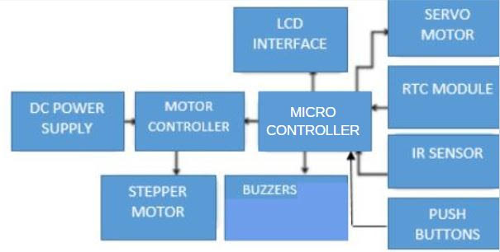
Complete Block Diagram of Proposed System
Fig. 1 Block Diagram

Slide 6
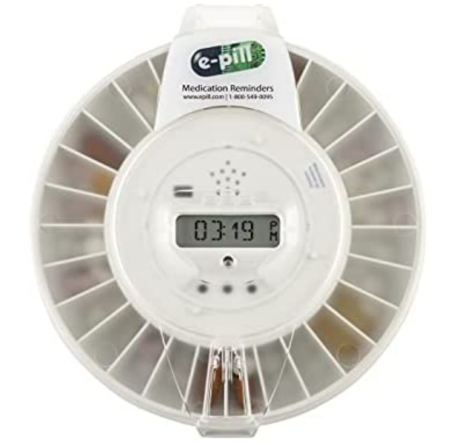
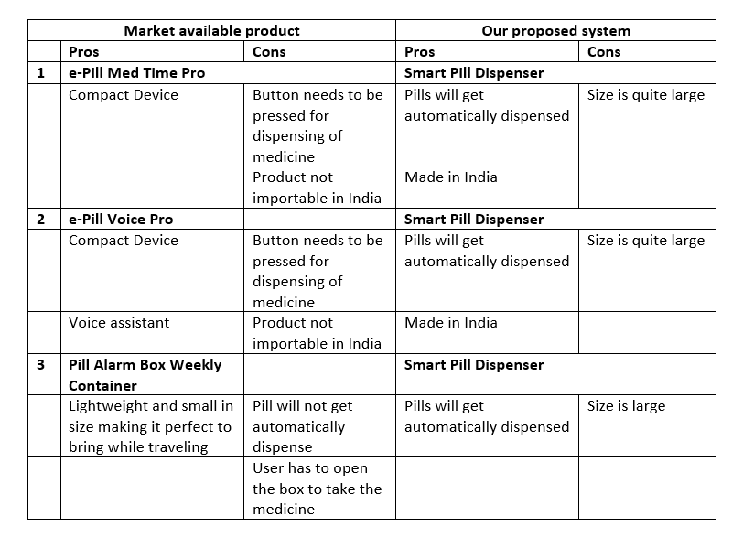
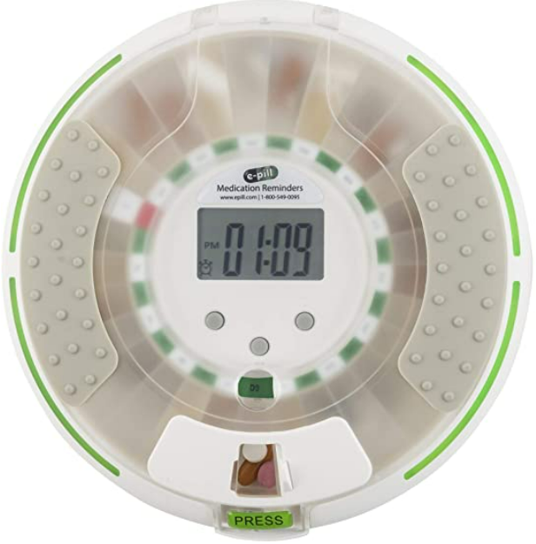
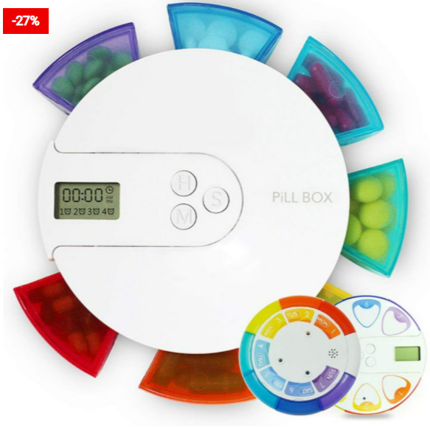
Comparison in the market

Slide 7
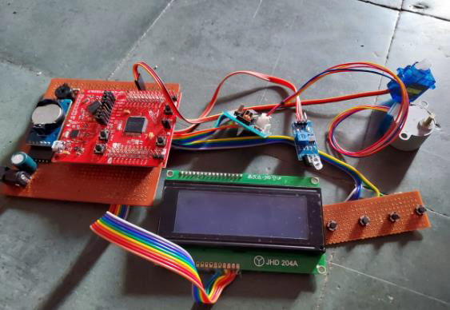
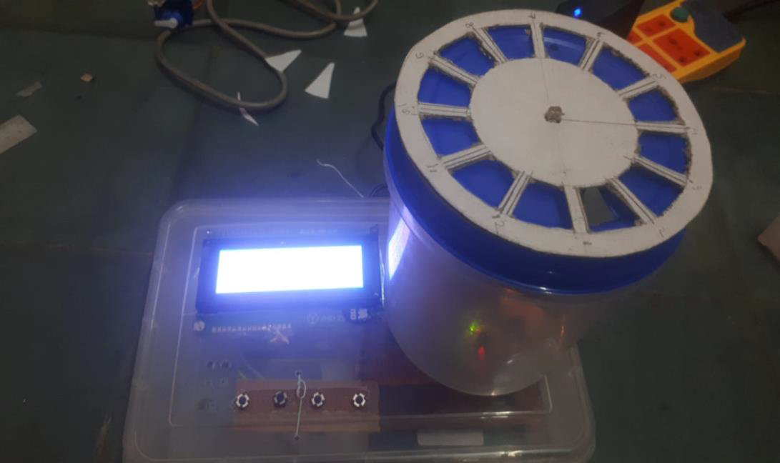
Hardware implementation and results

Slide 8

Hardware implementation and results

Slide 9
Benefits to Our Society
The elderly with poor memory have a major problem in recognizing the medicinal doses. This problem can be solved using this device.
It is helpful for busier and old age people. Also, Many seniors who suffer from dementia or Alzheimer’s may not remember when to take their medication or what medication to take.
In times of the COVID-19 pandemic, where we need to follow self-quarantine, there is a need for a pill dispenser that will be used by the infected people. The patients are able to take medicine without close professional supervision.
Our project will improve our existing healthcare industry, and also contributes to Atmanirbhar Bharat Abhiyan.

Slide 10
References
[1] R. L. Ownby, “Medication adherence and cognition: medical, personal and economic factors influence level of adherence in older adults,” Geriatrics, vol. 61, no. 2, pp. 30–35, 2006.
[2] S. Mukund and N.K. Srinath, ”Design of Automatic Medication Dispenser” , International Conference of Advanced Computer Science & Information Technology, Karol Bagh, New Delhi, Dec. 2012, pp. 127–133.
[3] Mrityunjaya. H, Kartik. U, Teja. B and Kotresh.H , ”Automatic Pill Dispenser ”, International Journal Of Advanced Research in Computer and Communication Engineering, vol. 52, no. 22, pp. 47–54, 2016.
[4] Naga Udayini Nyapathi, Bhargavi Pendlimarri, Karishma Sk, Kavya Ch, “Smart Medicine Box using ARM7 Microcontroller” International Research Journal of Engineering and Technology (IRJET), vol. 38, no. 9, pp. 14–28, 2016.
2

